Slide 1



Report 2
View in Power BI
Last data refresh:
13/09/2024 03:06:57 UTC
Downloaded at:
06/11/2024 03:57:55 UTC

Slide 2
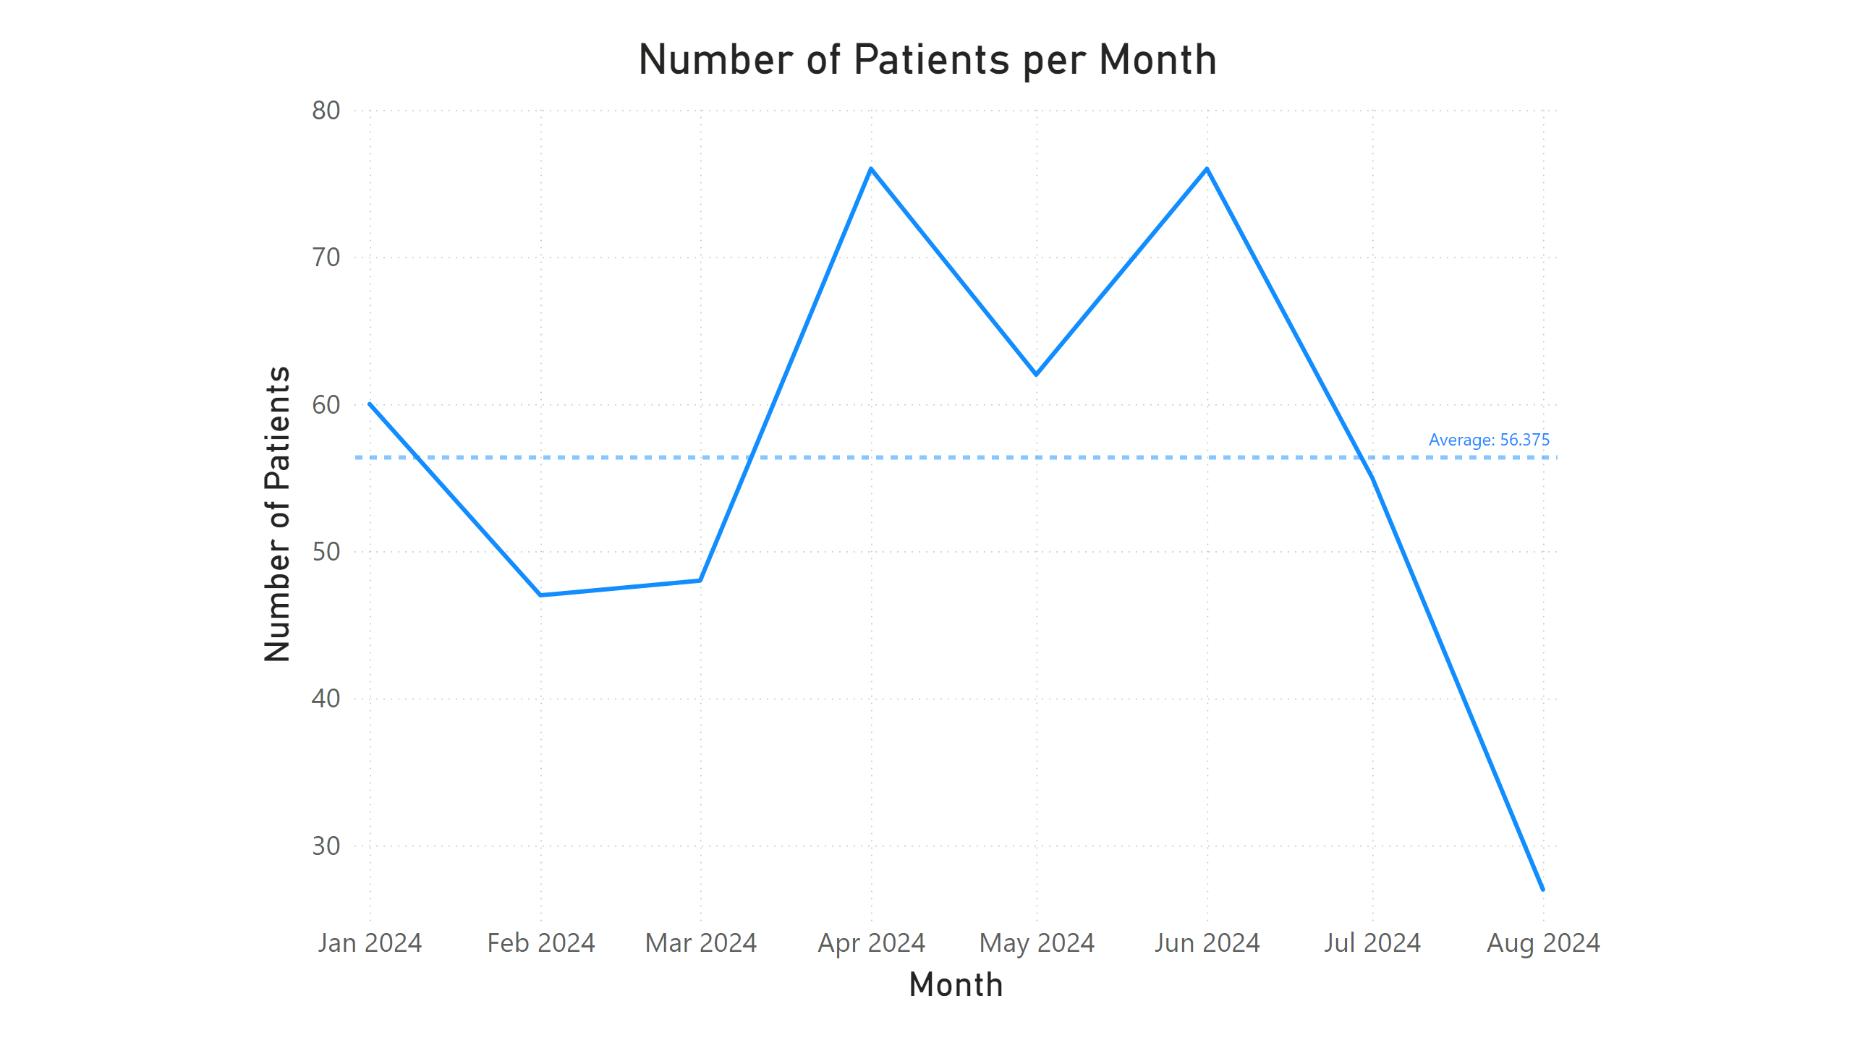
Page 1
Notes:
Number of Patients per Month
No alt text provided

Slide 3
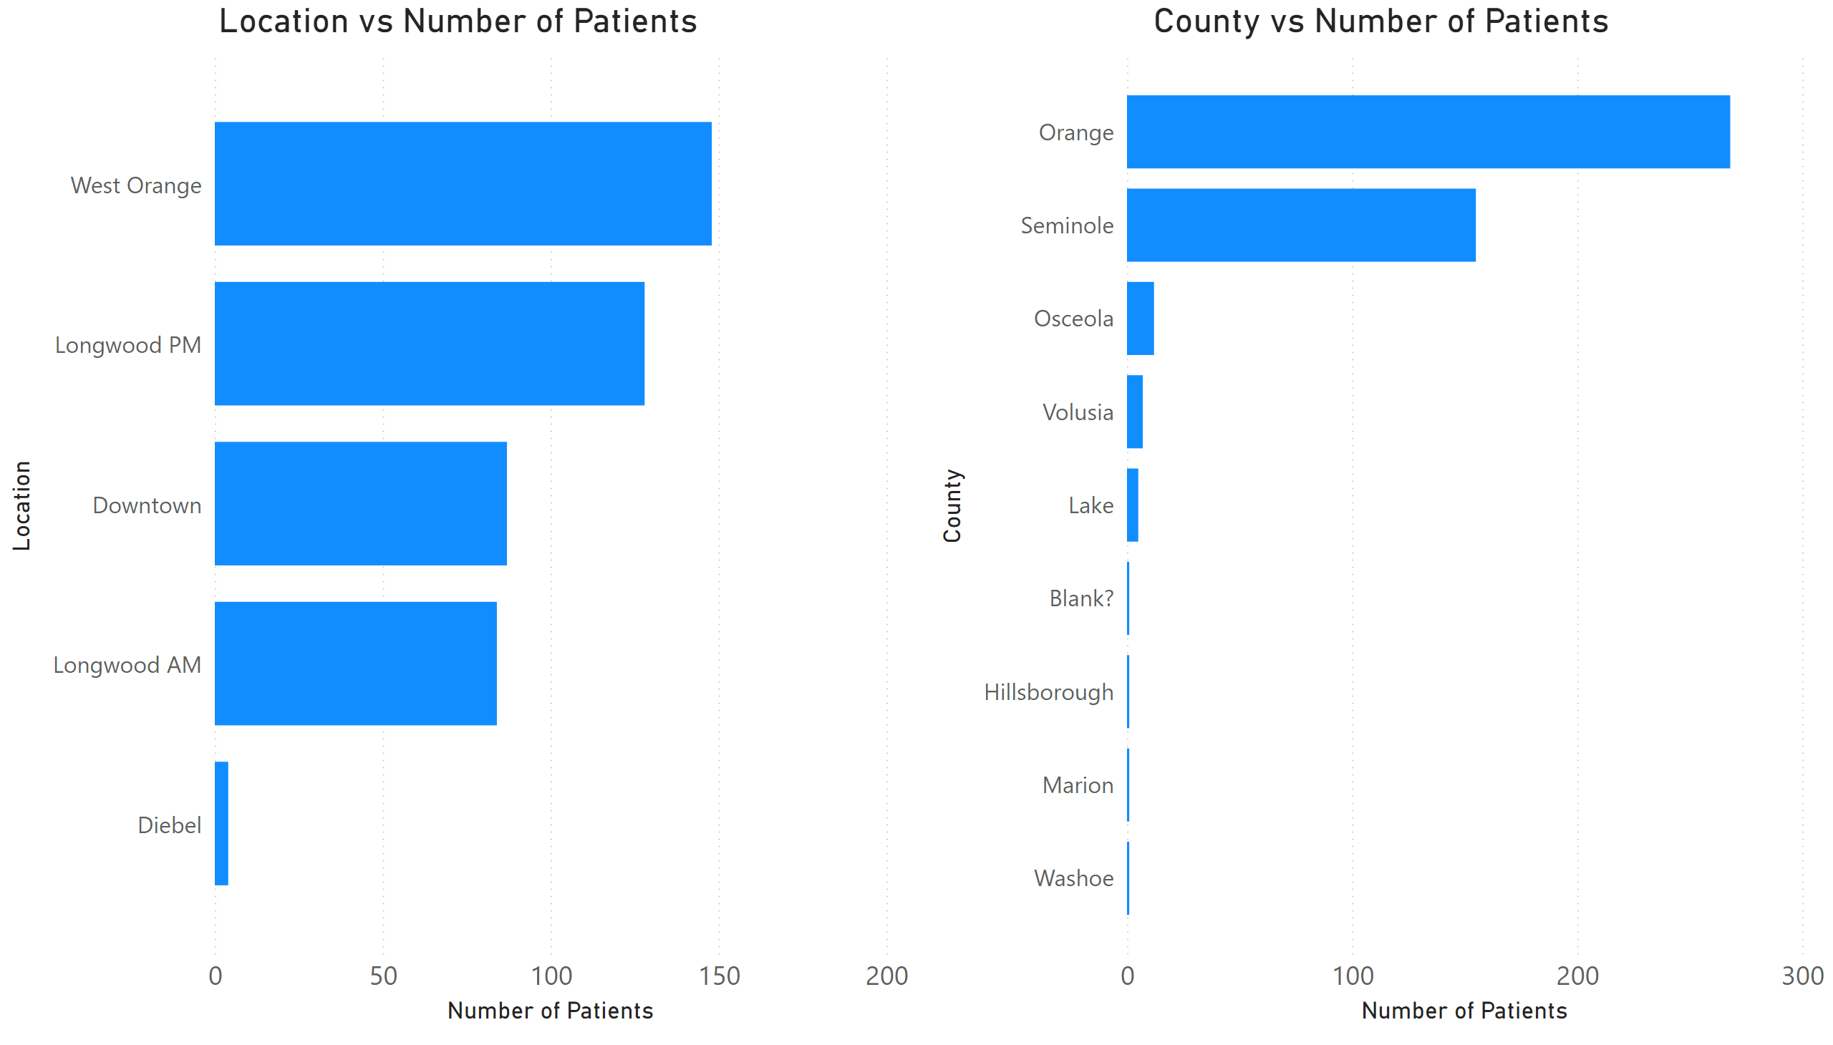
Page 2
Notes:
Location vs Number of Patients
No alt text provided
County vs Number of Patients
No alt text provided

Slide 4
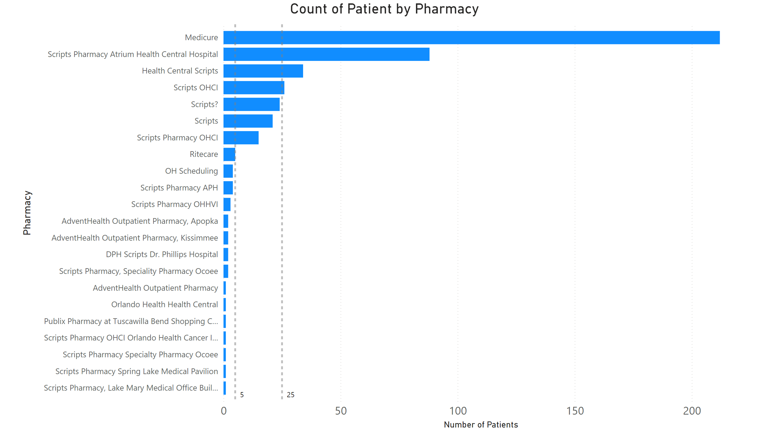
Page 3
Notes:
Count of Patient by Pharmacy
No alt text provided

